Slide 1

Income Taxes and the Net Present Value Method
Appendix 14C
Managerial Accounting
Seventeenth edition

Slide 2
Learning Objective 8
14-C2
Include income taxes in a net present value analysis.

Slide 3
Simplifying Assumptions – Part 1
14-C3
A company’s net income for financial reporting purposes equals its taxable income.
The tax rate is a flat percentage of taxable income.
A noncurrent asset’s useful life is the same for financial reporting and tax purposes.

Slide 4
Simplifying Assumptions – Part 2
14-C4
Straight-line depreciation is always used for financial reporting and tax purposes.
There are no gains or losses on the sale of noncurrent assets.
Noncurrent assets always have a salvage value of zero for financial reporting and tax purposes.

Slide 5
Key Concepts – Part 1
14-C5
To calculate the amount of income tax expense associated with a capital budgeting project, we’ll be using a two-step process:
First
Second
Calculate the incremental net income earned during each year of the project.
Multiply each year’s incremental net income by the tax rate to determine the income tax expense.

Slide 6
Key Concepts – Part 2
14-C6
A capital budgeting project’s incremental net income computations include:
  Annual revenues.
  Annual cash operating expenses.
  Annual depreciation expense.
  One-time expenses related to repairs and maintenance.

Slide 7
Key Concepts – Part 3
14-C7
A capital budgeting project’s incremental net income computations exclude:
  Immediate investments in equipment, other assets, and installation costs.
  Investments in working capital.
  The release of working capital.
  The proceeds from selling a noncurrent asset when no gain or loss is realized on the sale.

Slide 8
Holland Company – Example – Part 1
14-C8
Holland Company owns the mineral rights to land that has a deposit of ore. The company is deciding whether to purchase equipment and open a mine on the property. The mine would be depleted and closed in 5 years and the equipment would be sold for its salvage value.
More information is provided on the next slide.

Slide 9
Holland Company – Example – Part 2
14-C9
Should Holland open a mine on the property?

Slide 10
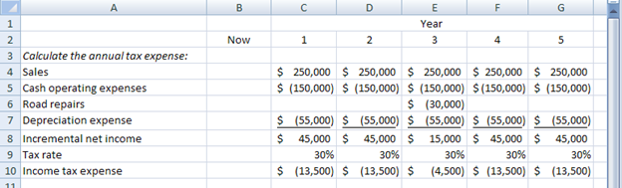
Holland Company – Example – Part 3
14-C10
First
Calculate the incremental net income earned during each year of the project.

Slide 11
Holland Company – Example – Part 4
14-C11
Second
Multiply each year’s incremental net income by the tax rate to determine the income tax expense.

Slide 12
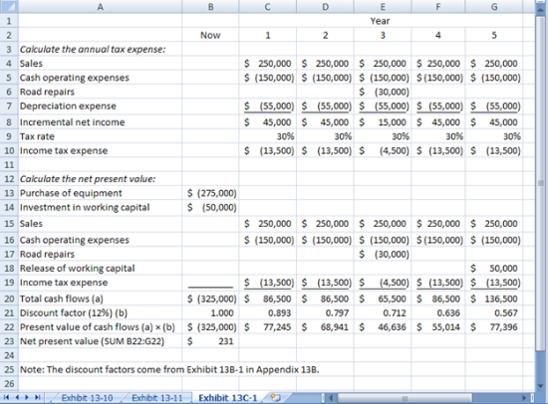
Holland Company – Example – Part 5
14-C12
The net present value computations include the following:
232

Slide 13
Holland Company – Example – Part 6
14-C13
Each year’s total cash flows are multiplied by the appropriate discount factor for 12% to compute their lesser present value.
232

Slide 14
Holland Company – Example – Part 7
14-C14
The present values in cells B22 through G22 are combined to determine the project’s net present value of $232.
The positive net present value indicates that Holland Company should proceed with the mining project.
232
Notes:
Note that the '$231' value in B23 should be changed to read '$232.'

Slide 15
End of Chapter 14C
14-C15

